Slide 1

Heaven’s light is our guide”
Rajshahi University of Engineering & Technology
Department of Computer Science & Engineering
Data Communication
Course No. : CSE 3103
Chapter 5: Analog Transmission
Prepared By : Julia Rahman

Slide 2
5.1 DIGITAL-TO-ANALOG CONVERSION
Julia Rahman, Dept. CSE, RUET
02

Slide 3
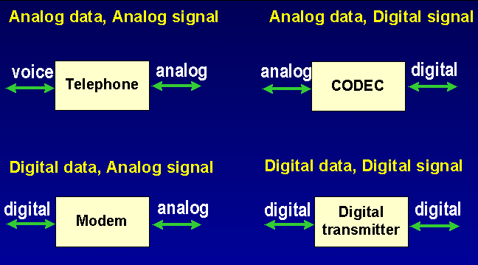
5-1 Digital-To-Analog Conversion
Data Encoding refers the various techniques of impressing data (0,1) or information on an electrical, electromagnetic or optical signal that would propagate through the physical medium making up the communication link between the two devices.
Julia Rahman, Dept. CSE, RUET
03

Slide 4
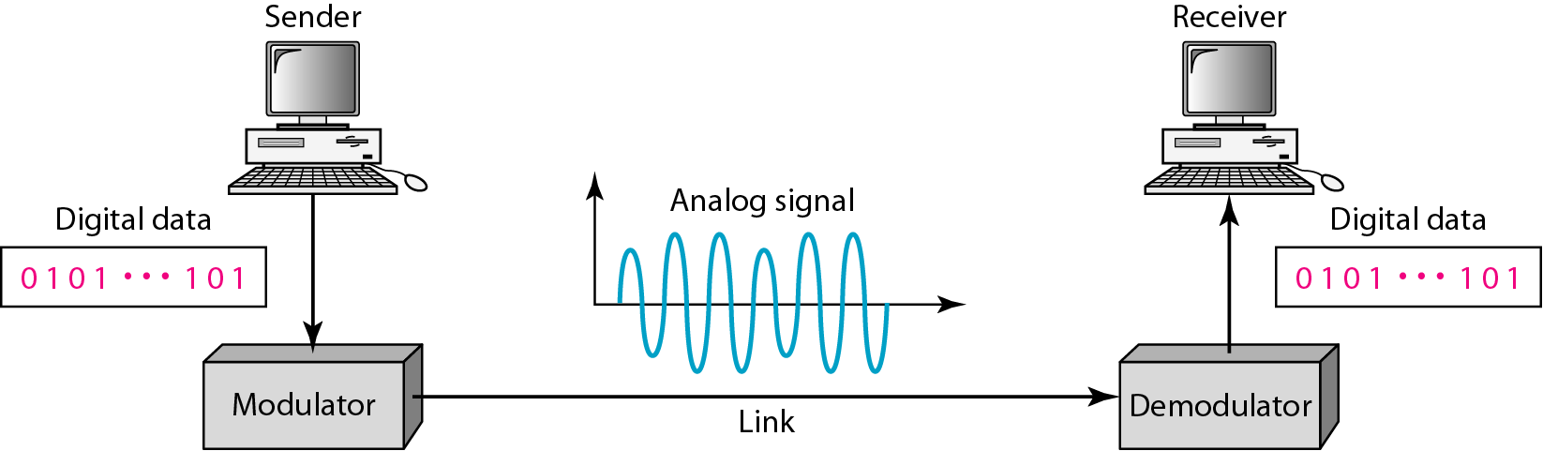
5-1 Digital-To-Analog Conversion
Digital-to-analog conversion is the process of changing one of the characteristics of an analog signal based on the information in digital data.
Figure 5.1 Digital-to-analog conversion
Julia Rahman, Dept. CSE, RUET
04

Slide 5
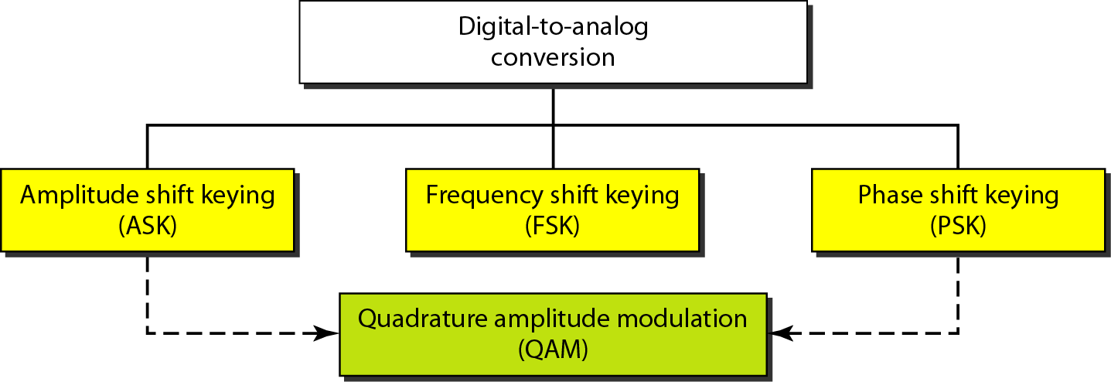
5-1 Digital-To-Analog Conversion
Figure 5.2 Types of digital-to-analog conversion
Julia Rahman, Dept. CSE, RUET
05

Slide 6
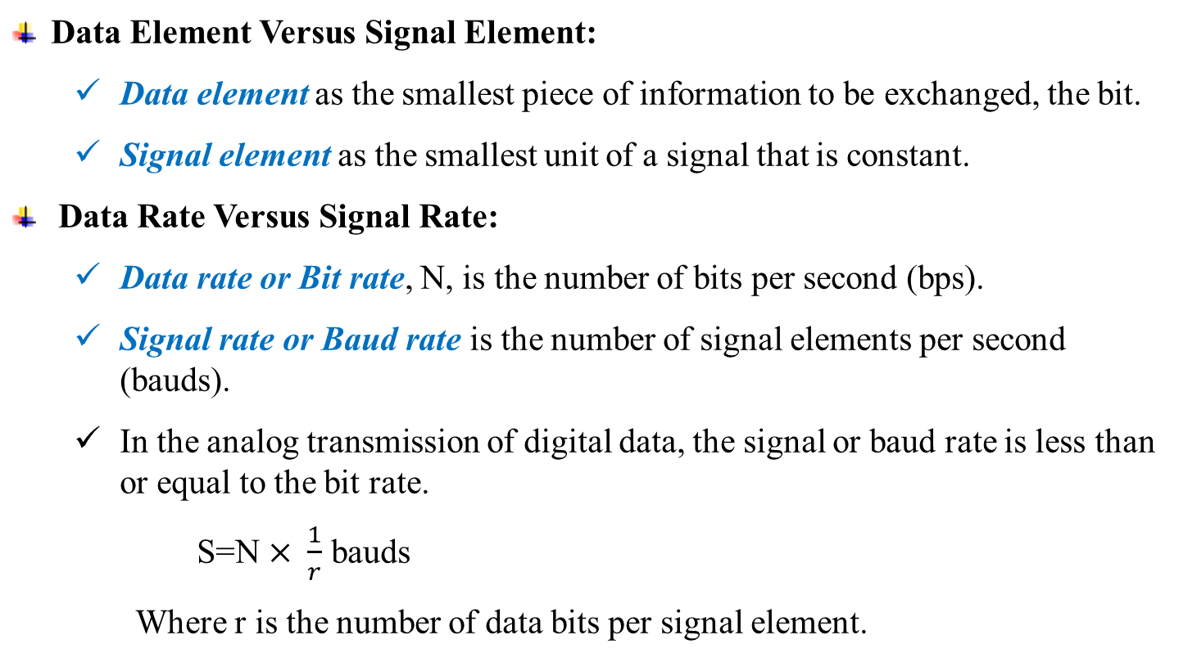
5-1 Digital-To-Analog Conversion
Data Element Versus Signal Element:
Data element as the smallest piece of information to be exchanged, the bit.
Signal element as the smallest unit of a signal that is constant.
Data Rate Versus Signal Rate:
Data rate or Bit rate, N, is the number of bits per second (bps).
Signal rate or Baud rate is the number of signal elements per second (bauds).
In the analog transmission of digital data, the signal or baud rate is less than or equal to the bit rate.
S=N $× \frac{1}{r}$ bauds
Where r is the number of data bits per signal element.
Julia Rahman, Dept. CSE, RUET
06

Slide 7
5-1 Digital-To-Analog Conversion
Example 5.1: An analog signal carries 4 bits per signal element. If 1000 signal elements are sent per second, find the bit rate.
Solution: In this case, r = 4, S = 1000, and N is unknown. We can find the value of N from
Example 5.2: An analog signal has a bit rate of 8000 bps and a baud rate of 1000 baud. How many data elements are carried by each signal element? How many signal elements do we need?
Solution: In this example, S = 1000, N = 8000, and r and L are unknown. We find first the value of r and then the value of L.
Julia Rahman, Dept. CSE, RUET
07

Slide 8
5-1 Digital-To-Analog Conversion
Bandwidth:
The required bandwidth for analog transmission of digital data is proportional to the signal rate except for FSK.
Carrier Signal:
Carrier Signal - High-frequency signal used for digital-to-analog or analog-to-digital modulation
Sending device produces a high-frequency signal that acts as a base for the information signal. This base signal is called the carrier signal or carrier frequency.
The receiving device is tuned to the frequency of the carrier signal that it expects from the sender.
Digital information then changes the carrier signal by modifying one or more of its characteristics (amplitude, frequency, or phase). This kind of modification is called modulation (shift keying).
Julia Rahman, Dept. CSE, RUET
08

Slide 9
5-1 Digital-To-Analog Conversion
Amplitude Shift Keying (ASK):
ASK is implemented by changing the amplitude of a carrier signal to reflect amplitude levels in the digital signal.
Frequency and phase remain constant while amplitude is changed.
Highly susceptible to noise interference since noise usually affects amplitude
Minimum bandwidth required is equal to baud rate
Binary ASK (BASK)
ASK is normally implemented using only two levels. This is referred to as binary amplitude shift keying or on-off keying (OOK).
The peak amplitude of one signal level is 0; the other is the same as the amplitude of the carrier frequency.
Bandwidth of ASK:
The bandwidth B of ASK is proportional to the signal rate S.
B = (1+d)S
“d” is due to modulation and filtering, lies between 0 and 1.
Julia Rahman, Dept. CSE, RUET
09

Slide 10
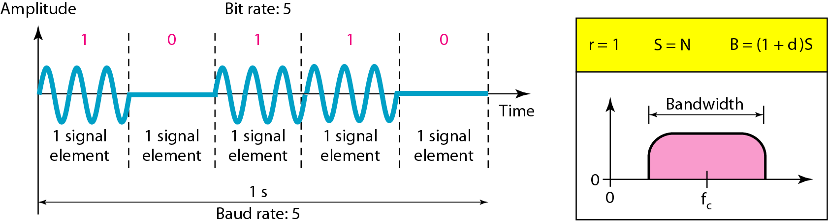
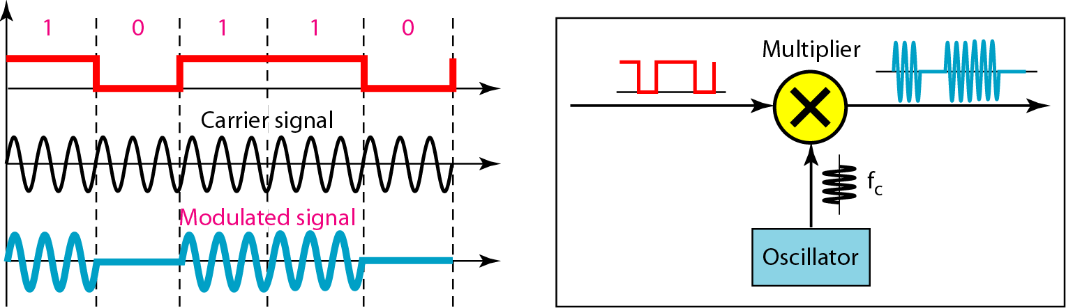
5-1 Digital-To-Analog Conversion
Figure 5.3 Binary amplitude shift keying
Figure 5.4 Implementation of binary ASK
Julia Rahman, Dept. CSE, RUET
10

Slide 11
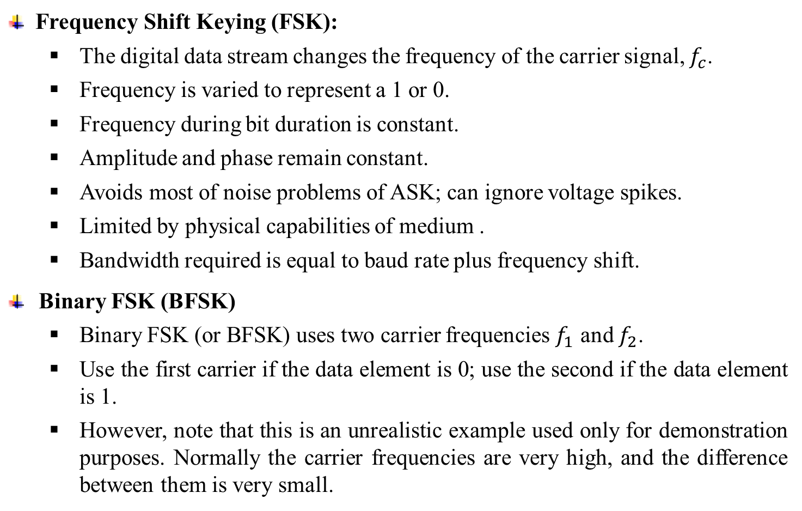
5-1 Digital-To-Analog Conversion
Frequency Shift Keying (FSK):
The digital data stream changes the frequency of the carrier signal, $f_{c}$.
Frequency is varied to represent a 1 or 0.
Frequency during bit duration is constant.
Amplitude and phase remain constant.
Avoids most of noise problems of ASK; can ignore voltage spikes.
Limited by physical capabilities of medium .
Bandwidth required is equal to baud rate plus frequency shift.
Binary FSK (BFSK)
Binary FSK (or BFSK) uses two carrier frequencies $f_{1}$ and $f_{2}$.
Use the first carrier if the data element is 0; use the second if the data element is 1.
However, note that this is an unrealistic example used only for demonstration purposes. Normally the carrier frequencies are very high, and the difference between them is very small.
Julia Rahman, Dept. CSE, RUET
11

Slide 12
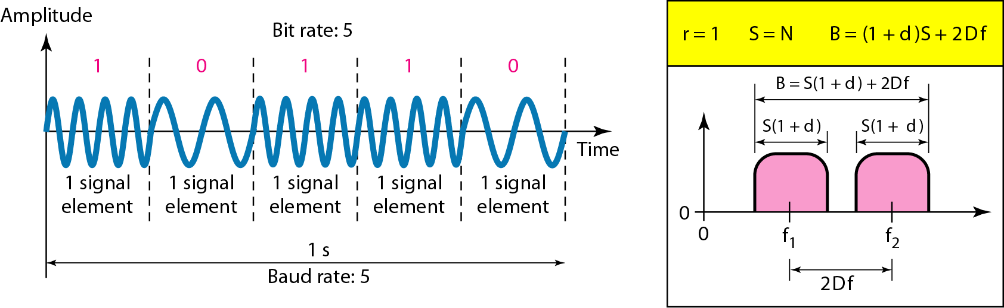
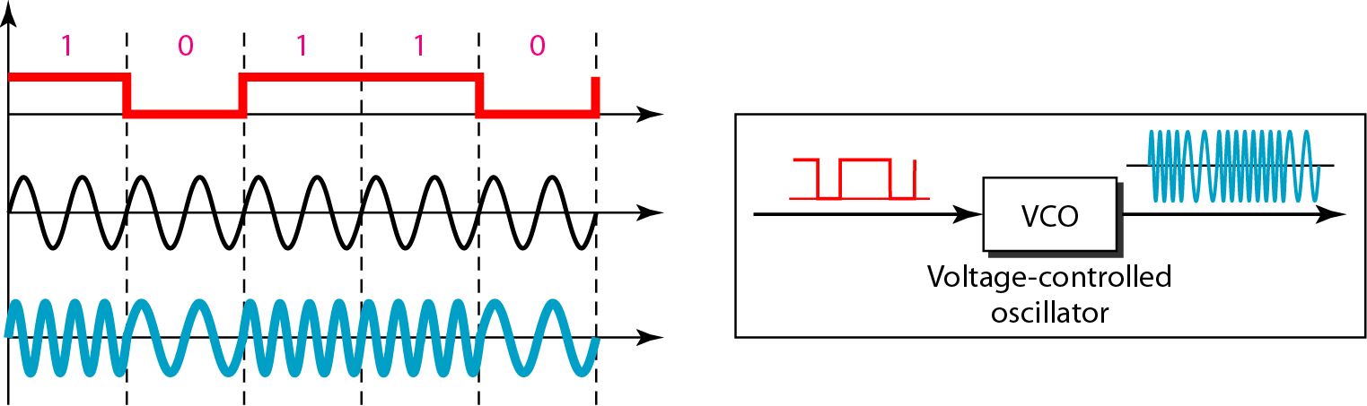
5-1 Digital-To-Analog Conversion
Figure 5.6 Binary frequency shift keying
Julia Rahman, Dept. CSE, RUET
12

Slide 13
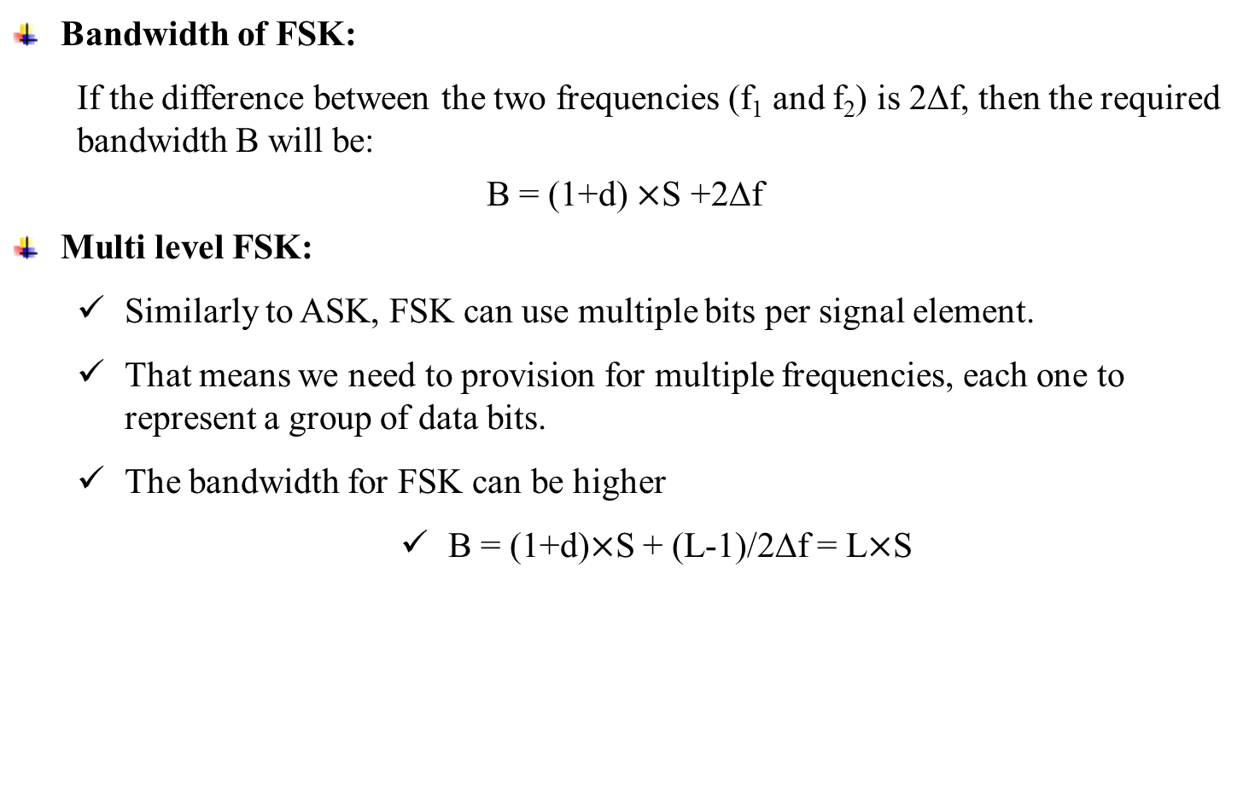
5-1 Digital-To-Analog Conversion
Bandwidth of FSK:
If the difference between the two frequencies (f₁ and f₂) is 2Δf, then the required bandwidth B will be:
B = (1+d) $×$S +2Δf
Multi level FSK:
Similarly to ASK, FSK can use multiple bits per signal element.
That means we need to provision for multiple frequencies, each one to represent a group of data bits.
The bandwidth for FSK can be higher
B = (1+d)$×$S + (L-1)/2Δf = L$×$S
Julia Rahman, Dept. CSE, RUET
13

Slide 14
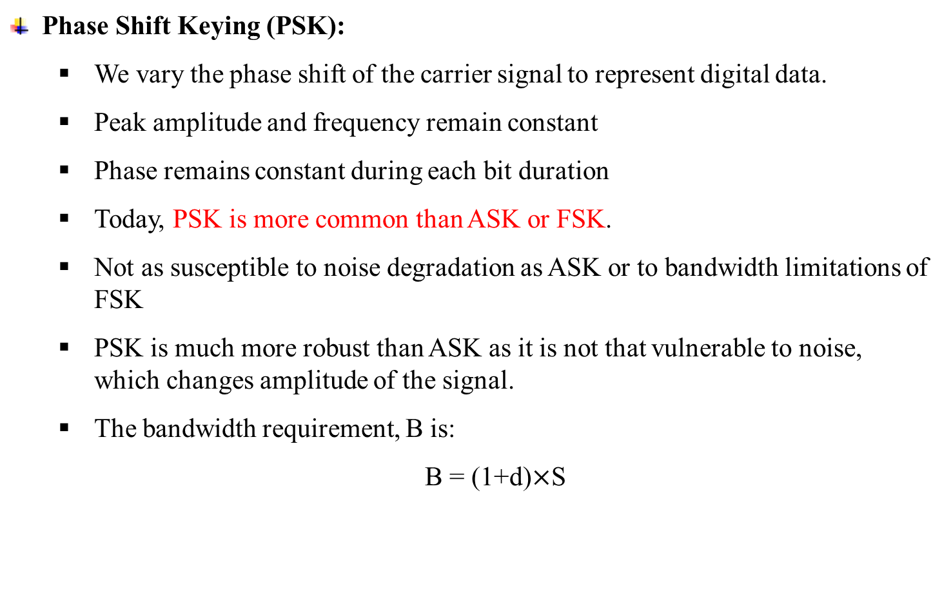
5-1 Digital-To-Analog Conversion
Phase Shift Keying (PSK):
We vary the phase shift of the carrier signal to represent digital data.
Peak amplitude and frequency remain constant
Phase remains constant during each bit duration
Today, PSK is more common than ASK or FSK.
Not as susceptible to noise degradation as ASK or to bandwidth limitations of FSK
PSK is much more robust than ASK as it is not that vulnerable to noise, which changes amplitude of the signal.
The bandwidth requirement, B is:
B = (1+d)$×$S
Julia Rahman, Dept. CSE, RUET
14

Slide 15
5-1 Digital-To-Analog Conversion
Binary PSK (BPSK):
The simplest PSK is binary PSK, in which we have only two signal elements, one with a phase of 0°, and the other with a phase of 180°.
Binary PSK is as simple as binary ASK with one big advantage-it is less susceptible to noise.
In ASK, the criterion for bit detection is the amplitude of the signal; in PSK, it is the phase. Noise can change the amplitude easier than it can change the phase.
In other words, PSK is less susceptible to noise than ASK. PSK is superior to FSK because we do not need two carrier signals.
Julia Rahman, Dept. CSE, RUET
15

Slide 16
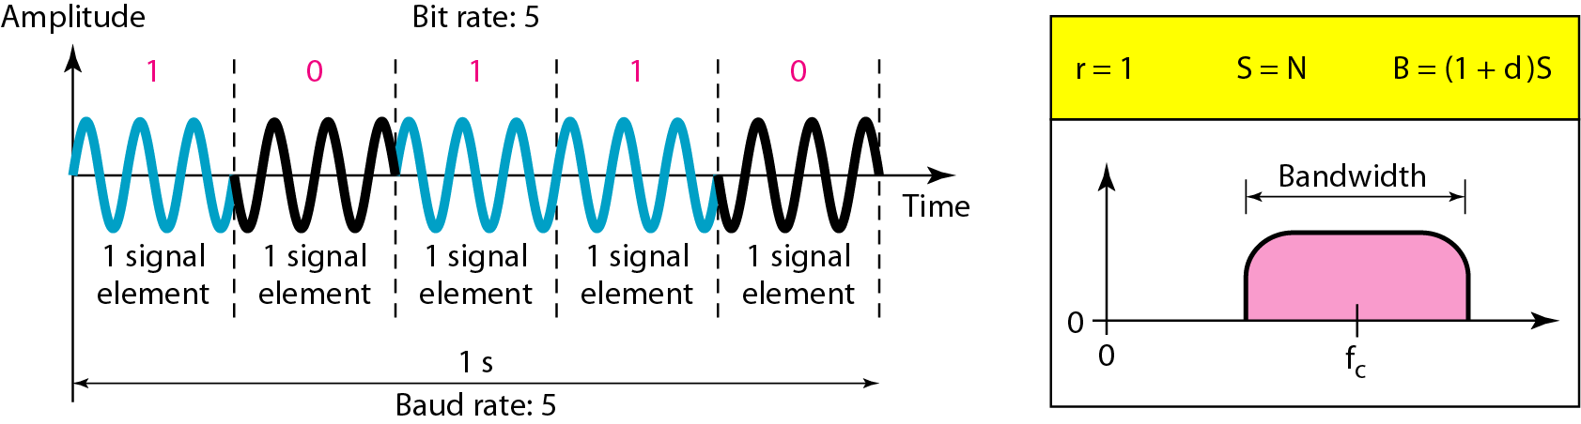
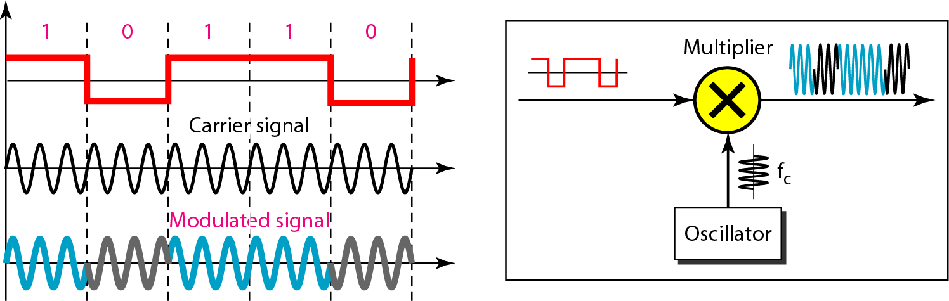
5-1 Digital-To-Analog Conversion
Figure 5.9 Binary phase shift keying
Figure 5.10 Implementation of BASK
Julia Rahman, Dept. CSE, RUET
16

Slide 17
5-1 Digital-To-Analog Conversion
Quadrature PSK:
To increase the bit rate, we can code 2 or more bits onto one signal element.
In QPSK, we parallelize the bit stream so that every two incoming bits are split up and PSK a carrier frequency. One carrier frequency is phase shifted 90o from the other - in quadrature.
The two PSKed signals are then added to produce one of 4 signal elements. L = 4 here.
Julia Rahman, Dept. CSE, RUET
17

Slide 18
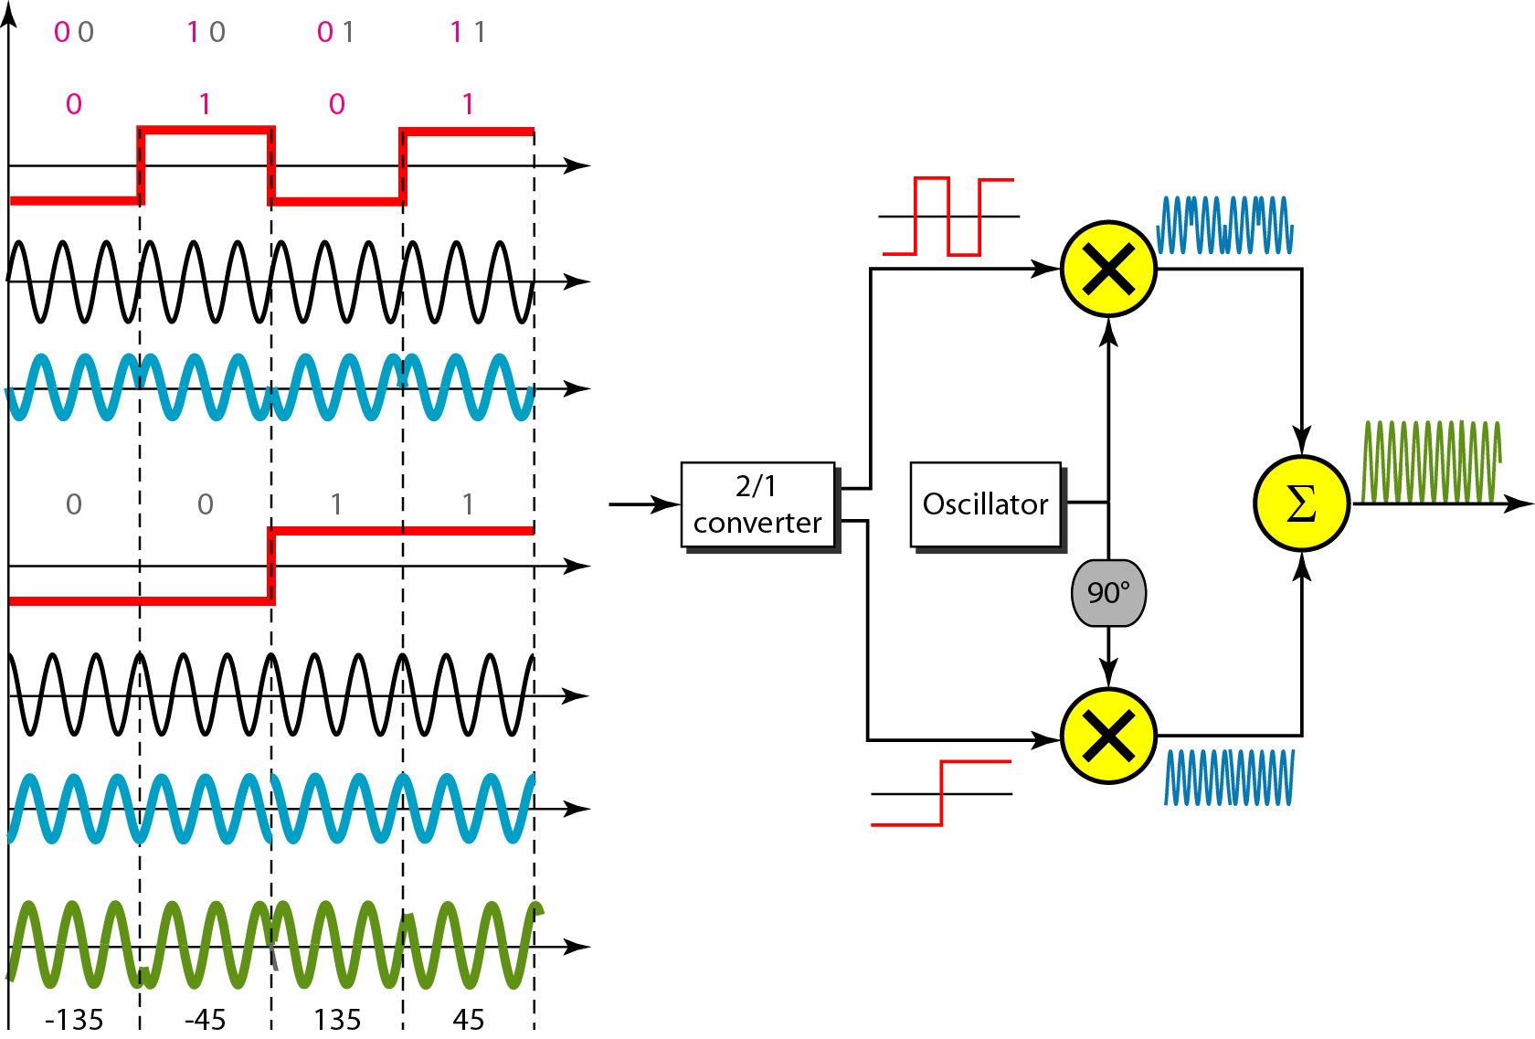
5-1 Digital-To-Analog Conversion
Figure 5.11 QPSK and its implementation
Julia Rahman, Dept. CSE, RUET
18

Slide 19
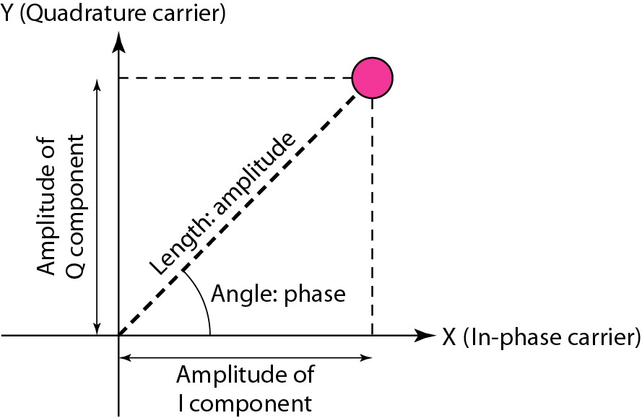
5-1 Digital-To-Analog Conversion
Constellation Diagrams:
Constellation is a graphical representation of the phase and amplitude of different bit combinations in digital-to-analog modulation.
A constellation diagram helps us to define the amplitude and phase of a signal when we are using two carriers, one in quadrature of the other.
The X-axis represents the in-phase carrier and the Y-axis represents quadrature carrier.
Figure 5.12 Concept of a constellation diagram
Julia Rahman, Dept. CSE, RUET
19

Slide 20
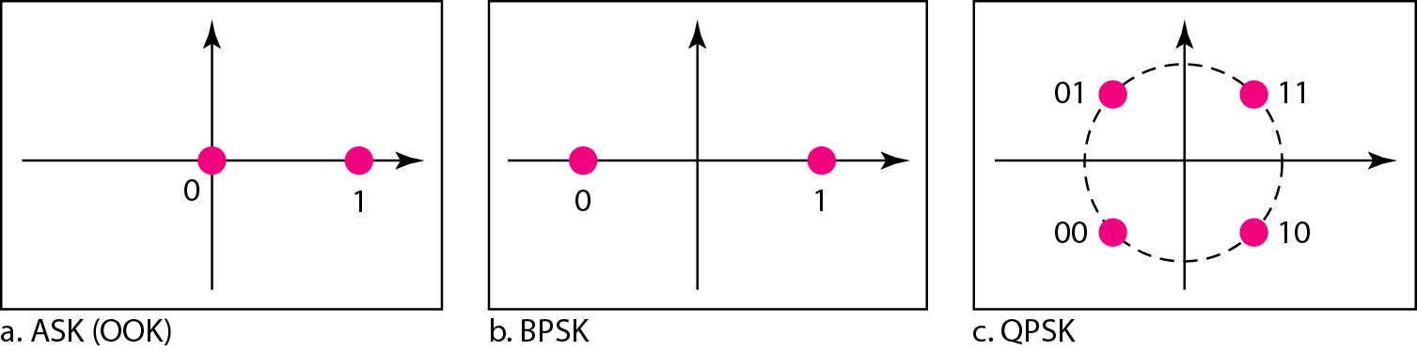
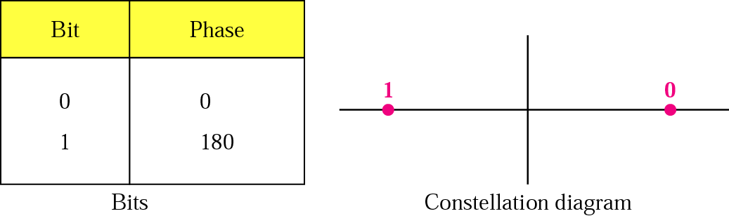
5-1 Digital-To-Analog Conversion
Example 5.8: Show the constellation diagrams for an ASK (OOK), BPSK, and QPSK signals.
Solution: Figure 5.13 shows the three constellation diagrams.
Figure 5.13 Three constellation diagrams
Figure PSK constellation
Julia Rahman, Dept. CSE, RUET
20

Slide 21
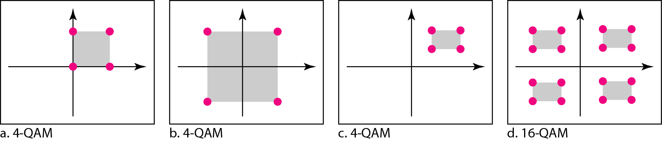
5-1 Digital-To-Analog Conversion
Quadrature Amplitude Modulation (QAM):
Quadrature amplitude modulation is a combination of ASK and PSK, so that a maximum contrast between each signal unit (bit, dibit, tribit, and so on) is achieved.
x number of variations in phase and y variations in amplitude
Number of phase shifts is always larger than number of amplitude shifts due to amplitude susceptibility to noise
QAM is therefore less susceptible to noise than ASK
Same bandwidth is required for ASK and PSK
Figure 5.14 Constellation diagrams for some QAMs
Julia Rahman, Dept. CSE, RUET
21

Slide 22
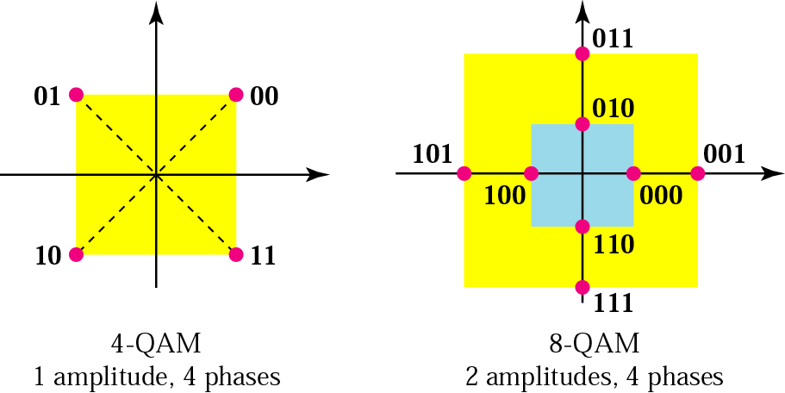
5-1 Digital-To-Analog Conversion
Figure 5.14 Constellation diagrams for some QAMs

Slide 23
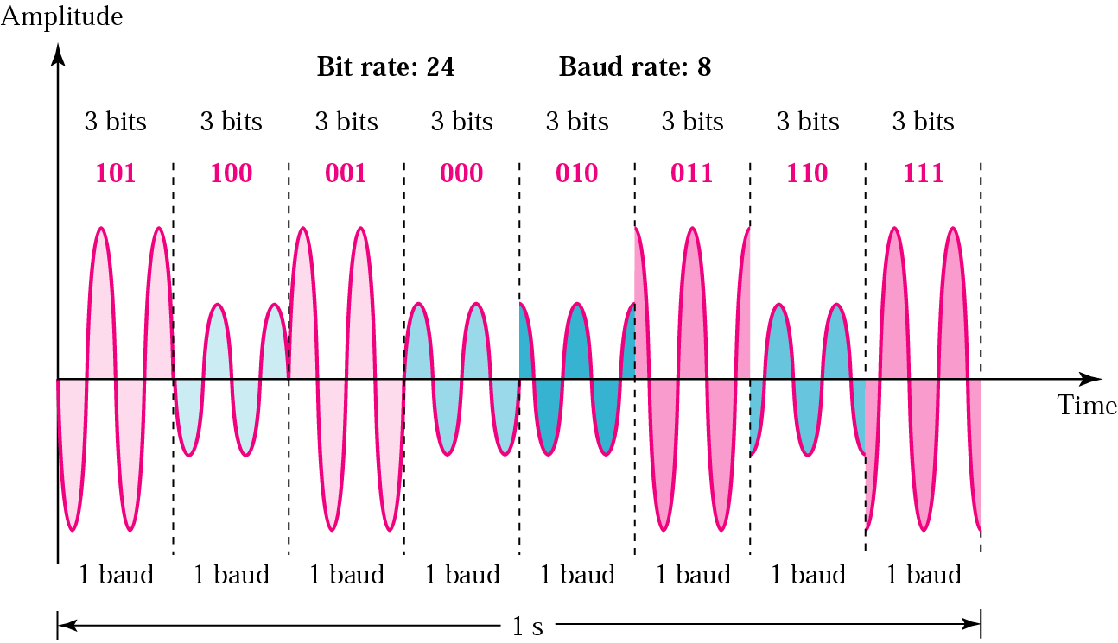
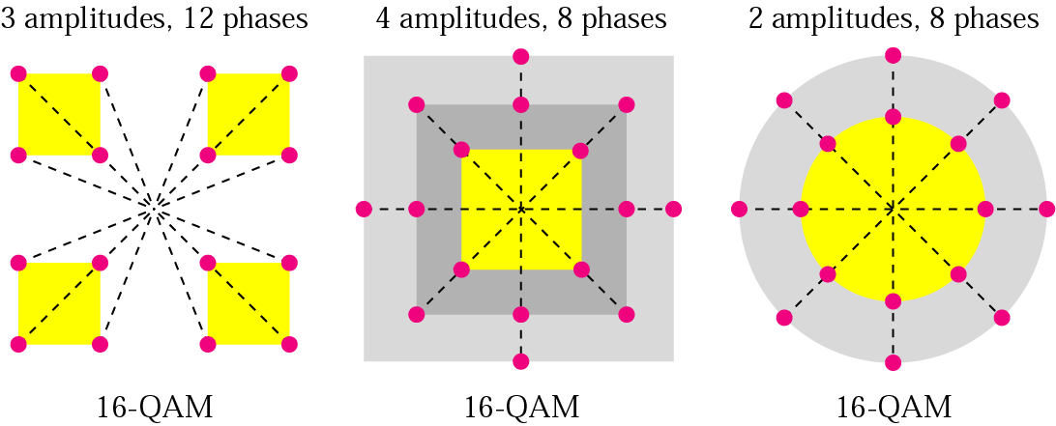
5-1 Digital-To-Analog Conversion

Slide 24
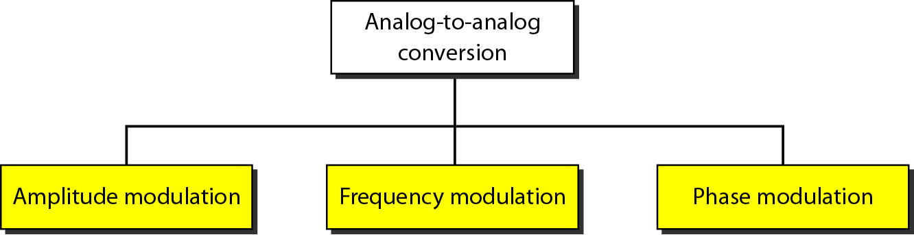
5-2 Analog-To-Analog Conversion
Analog-to-analog conversion is the representation of analog information by an analog signal. One may ask why we need to modulate an analog signal; it is already analog. Modulation is needed if the medium is bandpass in nature or if only a bandpass channel is available to us.
Figure 5.15 Types of analog-to-analog modulation

Slide 25
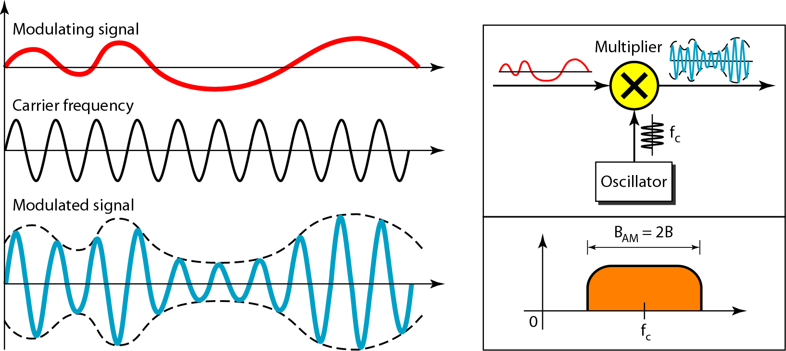
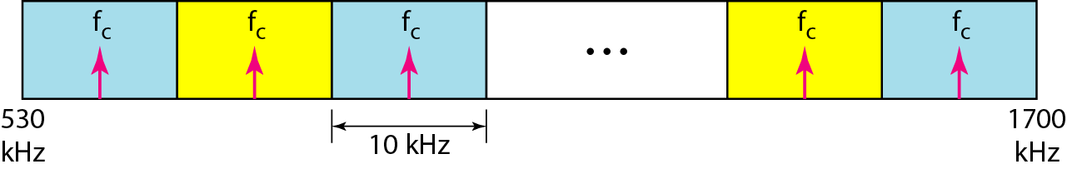
Figure 5.16 Amplitude modulation
Figure 5.17 AM band allocation

Slide 26
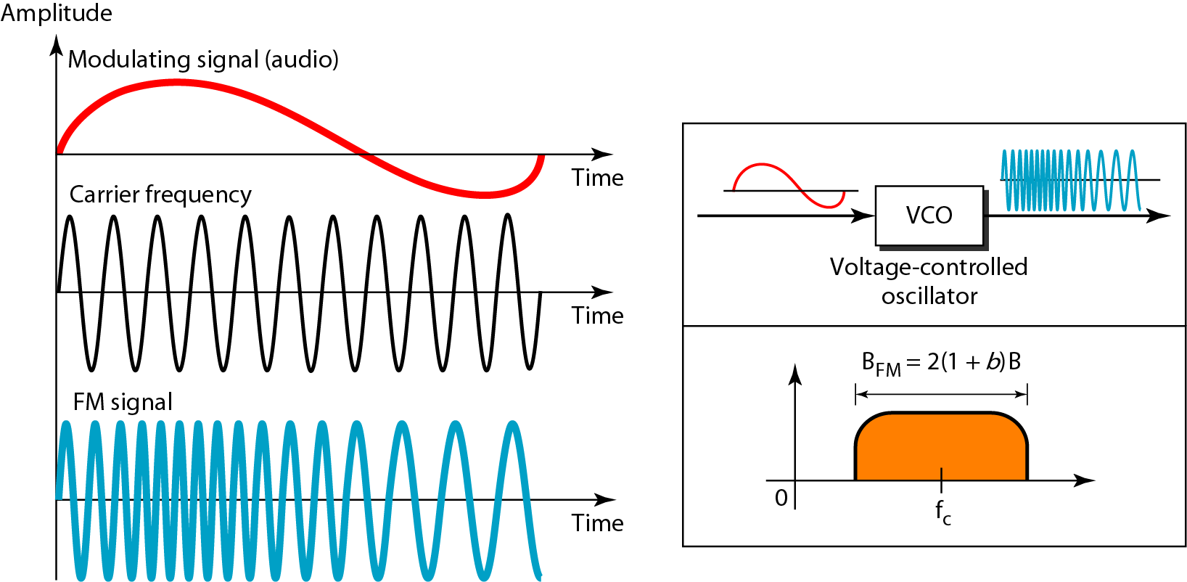
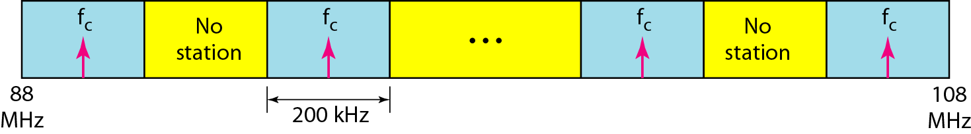
Figure 5.18 Frequency modulation
The total bandwidth required for FM can be determined from the bandwidth of the audio signal: B_{FM} = 2(1 + β)B.
Figure 5.19 FM band allocation

Slide 27
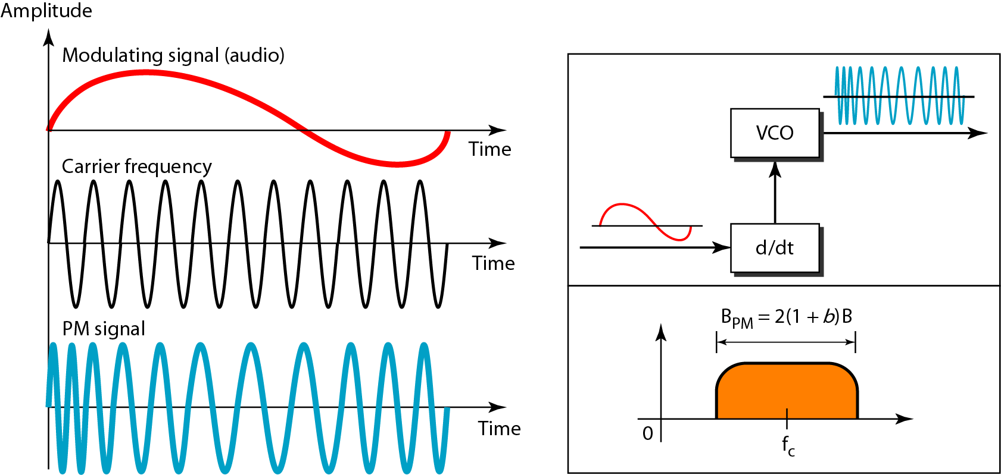
Figure 5.20 Phase modulation
The total bandwidth required for PM can be determined from the bandwidth and maximum amplitude of the modulating signal:B_{PM} = 2(1 + β)B.

